Slide 1
ETG Turbulence Simulation
Stefan Tirkas
University of Colorado, Boulder

Slide 2
Linear Runs

Slide 3
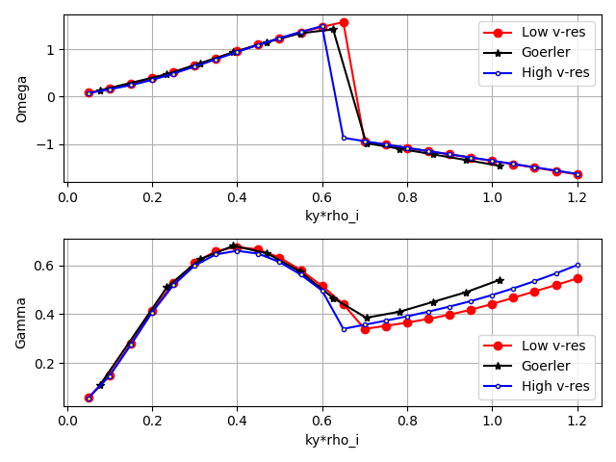
ITG Comparison with Goerler

Slide 4
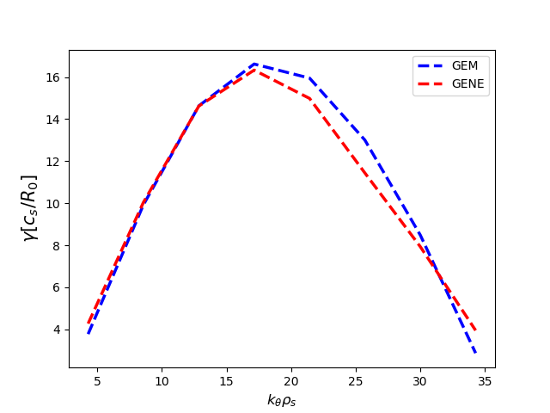
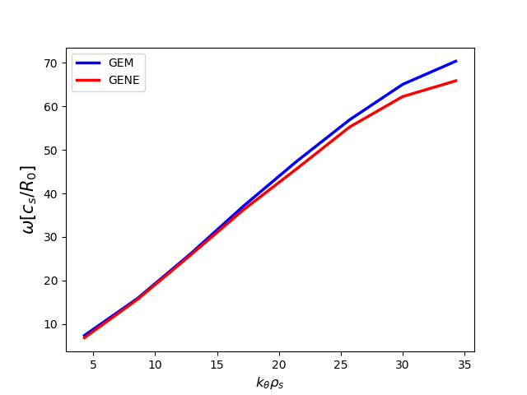
ETG Comparison with GEM -Haotian’s GEM results

Slide 5
Nonlinear Runs

Slide 6
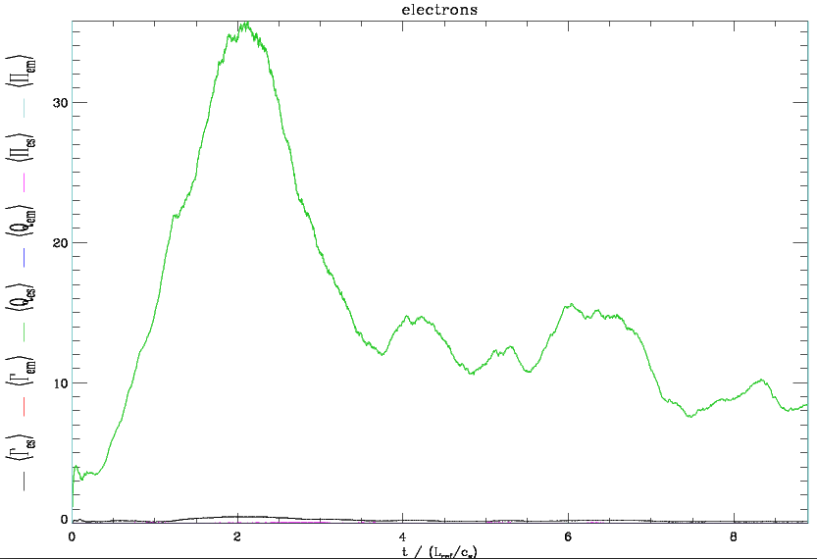
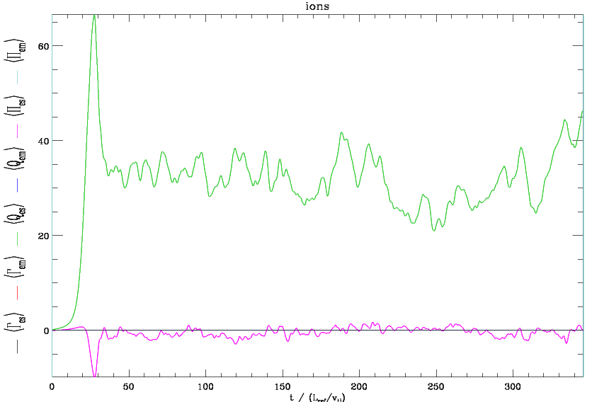
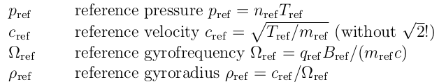
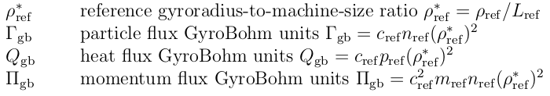
ETG
Cyclone ITG

Slide 8
GENE Diagnostics

Slide 9
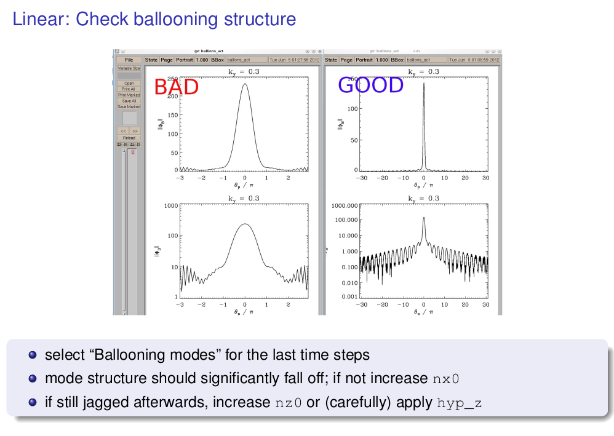

Slide 10
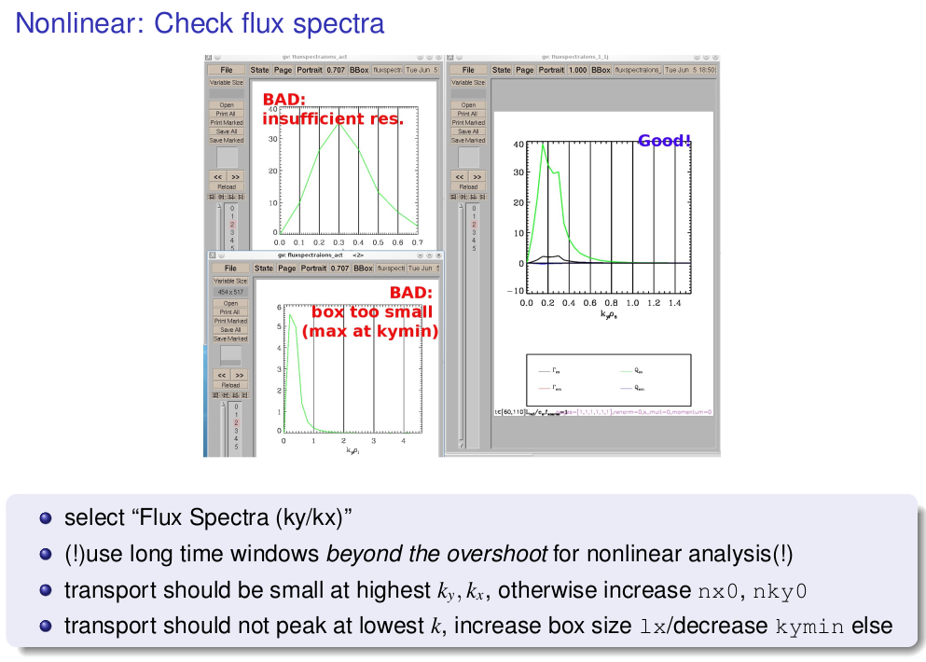

Slide 11
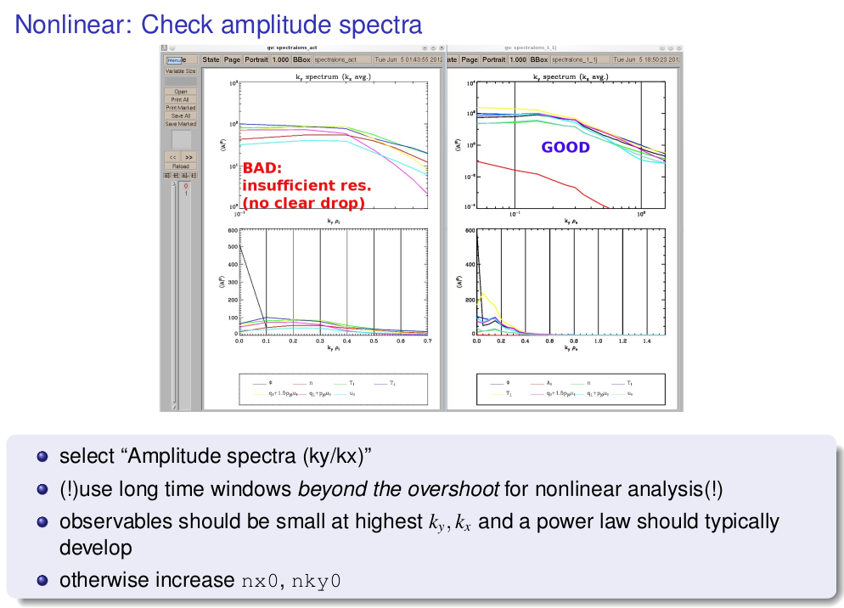

Slide 12
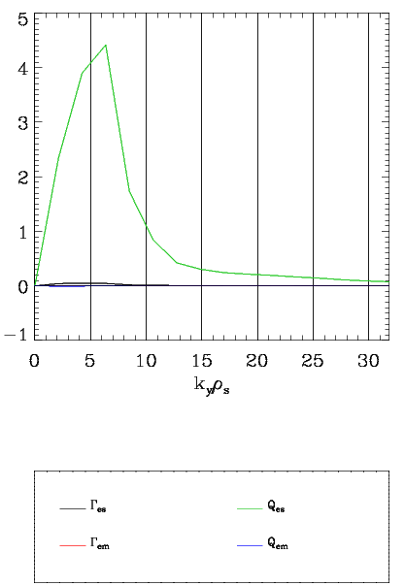
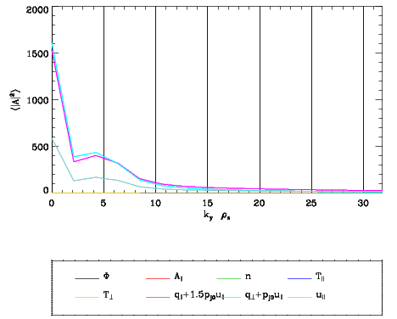
ETG Flux Spectra
ETG Amplitude Spectra

Slide 13
Hasegawa-Mima Equation
Partial differential equation derived from fluid continuity equation.
Describes a regime of plasma useful for describing turbulence in tokamak plasmas:
- cyclotron motion periods much shorter than the time scale quantities of interest are changing on (magnetic field, potential, densities).
- long length scales in the direction of the magnetic field
- quasi-neutral particle densities
- small ion temperature, so can neglect ion pressure
Shown to cause isotropic behavior for long wavelength modes.

Slide 14
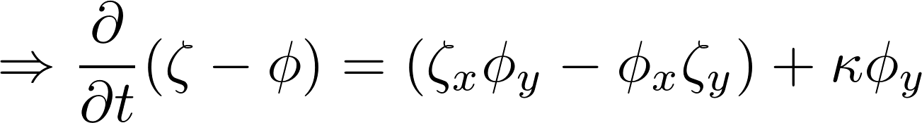
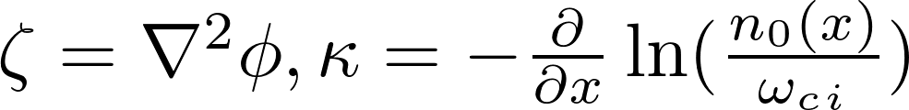
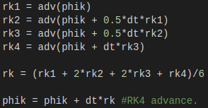
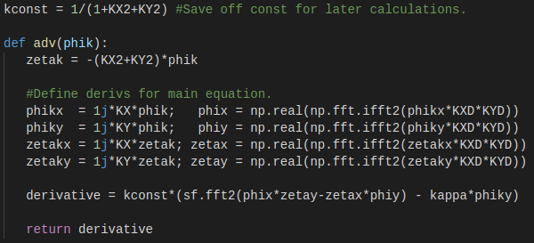

Slide 15
dt = 2e-1, nx = ny = 256

Slide 16
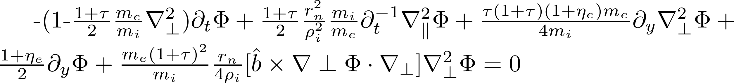
Future Plans
Convert HM code from ITG to Haotian’s ETG equations:
Initiate new code with GENE ETG run BCs and phi.
Expect ETG isotropization in slab geometry.

Slide 17
Multi-Scale Turbulence

Slide 18


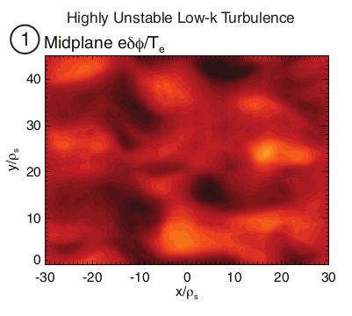
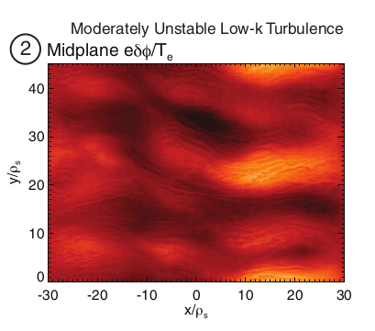
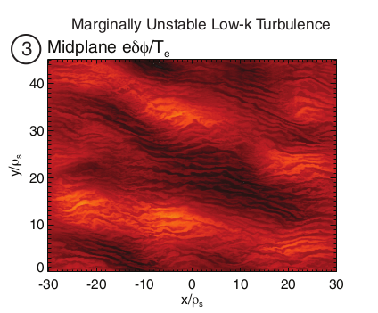
Parameters
- 100M NERSC Edison Hours - Run on GYRO
- - Box size 44x44
- Simulating RF-heated L-mode plasma in MIT Alcator C-Mod Tokamak
Snapshots of midplane electrostatic potential fluctuations for each multi-scale simulation. A clear transition from ITG dominated turbulence to ETG streamer dominated turbulence is seen between simulations #1-3.

